Slide 1

DATABASES COURSE 2023/2024
SESSION 3/4

Slide 2
SESSION 3
DATA IMPORTING
DML SELECT STATEMENT
DATE OPERATIONS
TEXT OPERATIONS
NUMBER OPERATIONS
DUMMY QUERIES

Slide 3
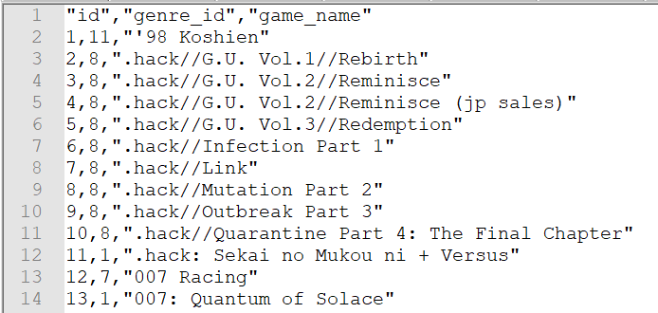
DATA IMPORTING
As Local Host
BBDD/User: mydata
MySQL
Oracle
CREATE TABLE game (
id INT,
genre_id INT,
game_name VARCHAR(150) );
CREATE TABLE game (
id NUMBER,
genre_id NUMBER,
game_name VARCHAR2(150) );
Notes:
Crear esquema/base de datos : “games”

Slide 4
DATA IMPORTING
As Local Host
MySQL
Oracle
LOAD DATA
INFILE 'D:/Programas/MySQL/Uploads/game.csv'
INTO TABLE game
FIELDS TERMINATED BY ','
ENCLOSED BY '"'
IGNORE 1 ROWS
( id,
genre_id,
game_name
);
Notes
The "load data" statement should be saved first in a control file (gameMySql.ctl)
INFILE Path should be the directory defined in "secure-file-priv" parameter inside "my.ini" file. Also this parameter can be shown by executing: SHOW VARIABLES LIKE "secure_file_priv";
OPTIONS (SKIP=1)
LOAD DATA
INFILE 'D:\Datos\Cursos\videogames\game.csv'
INTO TABLE game
FIELDS TERMINATED BY ','
OPTIONALLY ENCLOSED BY '"'
( id,
genre_id,
game_name
)
Notes
The "load data" statement should be saved first in a control file (gameOracle.ctl)

Slide 5
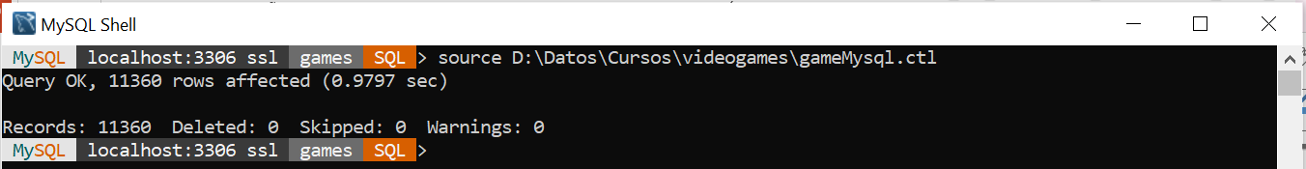
DATA IMPORTING
As Local Host
MySQL
Oracle
Notes: Once the loading process is completed, 2 files are generated
game.log : It contains information related the loading process
game.bad : It contains the rows which were not loaded for any reasons (if exists)

Slide 6
DATA IMPORTING
In Docker Container
Nº | STEP | MySQL | ORACLE
1 | Mysql container needs to be created with parameter :--secure-file-priv=docker-entrypoint-initdb.d | docker run --name mysql2 -p 3306:3306 -e MYSQL_ROOT_PASSWORD=my-secret-pw -d mysql:8 mysqld --default-authentication-plugin=mysql_native_password --secure-file-priv=docker-entrypoint-initdb.d
2 | In the ctl file, change the directory where csv file will be stored. Both (ctl and csv) will be stored in the same directory | Change "INFILE 'D:/Programas/MySQL/Uploads/game.csv'" By: "INFILE '/docker-entrypoint-initdb.d/game.csv'" | Change "INFILE 'D:\Datos\Cursos\videogames\game.csv'" By: "INFILE '/ORCL/game.csv'"
3 | Copy both (ctl and csv) into the specified directory inside the container | docker cp gameMySql.ctl mysql2:/docker-entrypoint-initdb.d/gameMySql.ctl docker cp game.csv mysql2:/docker-entrypoint-initdb.d/game.csv | docker cp gameOracle.ctl oracle:/ORCL/gameOracle.ctl docker cp game.csv oracle:/ORCL/game.csv
4 | Access the container and go to the directory where our files are stored | docker exec -it mysql2 bin/bash cd /docker-entrypoint-initdb.d | docker exec -it oracle bin/bash cd ORCL

Slide 7
DATA IMPORTING
In Docker Container
Nº | STEP | MySQL | ORACLE
5 | Oracle needs a configuration file to be executed |  | source /home/oracle/.bashrc
6 | Access to MySQL/Oracle and go the database/schema: games (crate it in case it does not exists). Password will be required. | mysql -u root -p use games | sqlplus Enter user-name: games Enter password: …
7 | Create the table (if it does not exists) | Use the create table statement from slide 3
8 | Before loading of the csv, Oracle needs to exit the sqlplus |  | quit
9 | Execute the loading csv process | source gameMySql.ctl | sqlldr CONTROL=gameOracle.ctl LOG=game.log

Slide 8
SESSION 3
DATA IMPORTING
DML SELECT STATEMENT
DATE OPERATIONS
TEXT OPERATIONS
NUMBER OPERATIONS
DUMMY QUERIES

Slide 9
DML SELECT STATEMENT
SELECT Syntax
MySQL/Oracle
SELECT field1, field2, ....
FROM table
WHERE field1 = Value1 AND
...
fieldN = ValueN;
MySQL/Oracle
SELECT alias.field1 AS Field1Alias, alias.field2 AS Field2Alias, field3 AS Field3Alias....
FROM table alias
WHERE alias.field1 = Value1 AND
...
alias.fieldN = ValueN;

Slide 10
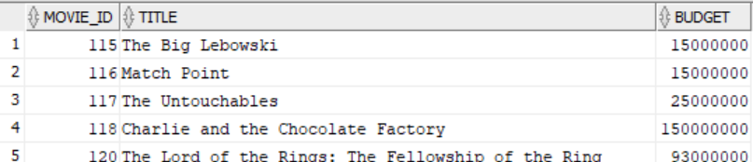
DML SELECT STATEMENT
SELECT Example
BBDD/User: moviebig
MySQL/Oracle
SELECT movie_id, title, budget
FROM moviebig
WHERE budget > 14000000

Slide 11
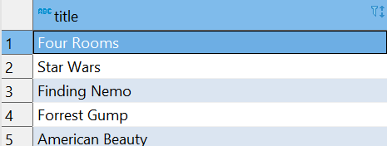
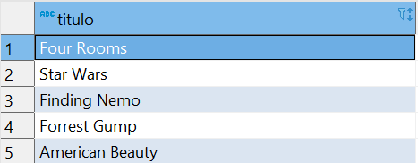
DML SELECT STATEMENT
Alias for Columns
BBDD/User: moviebig
MySQL/Oracle
SELECT title FROM moviebig;
MySQL/Oracle
SELECT title titulo FROM moviebig;
SELECT title AS titulo FROM moviebig;
SELECT title "titulo" FROM moviebig;
SELECT title AS "titulo" FROM moviebig;

Slide 12
DML SELECT STATEMENT
Alias for Tables
BBDD/User: moviebig
MySQL/Oracle
SELECT m.title FROM moviebig m;
MySQL
SELECT m.title FROM moviebig AS m;
Oracle
SELECT "m".title FROM moviebig "m";

Slide 13
SESSION 3
DATA IMPORTING
DML SELECT STATEMENT
DATE OPERATIONS
TEXT OPERATIONS
NUMBER OPERATIONS
DUMMY QUERIES

Slide 14
DATE OPERATIONS
DATE Conversion Functions Syntax
MySQL
MySQL
STR_TO_DATE(TextField,FormatDate)
FormatDate can be:
'%Y-%m-%d'
'%d/%m/%y'
'%Y%m%d'
Oracle
Oracle
TO_DATE(TextField,FormatDate)
FormatDate can be
'YYYY-MM-DD'
'DD/MM/YY'
'YYYYMMDD'

Slide 15
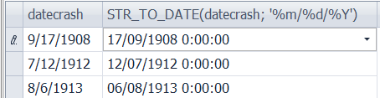
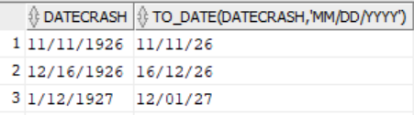
DATE OPERATIONS
DATE Conversion Functions Example
BBDD/User: airplanecrashes
MySQL
SELECT datecrash, STR_TO_DATE(datecrash, '%m/%d/%Y')
FROM crash;
Oracle
SELECT datecrash, TO_DATE(datecrash,'MM/DD/YYYY')
FROM crash;

Slide 16
DATE OPERATIONS
Time Addition Functions Syntax
MySQL
MySQL/Oracle
DATE_ADD(DateValue , INTERVAL 'value' unit)
Unit can be:
SECOND
MINUTE
HOUR
DAY
WEEK
MONTH
YEAR
etc
Oracle
DateValue + INTERVAL 'value' unit
NOTE: It is not recommended for adding months. Use instead: For Adding Months: ADD_MONTHS(DateValue + MonthsNumber)
Also
For Adding Days: DateValue + NumberOfDays
For Adding Years: ADD_MONTHS(DateValue + 12*NumberOfYears)

Slide 17
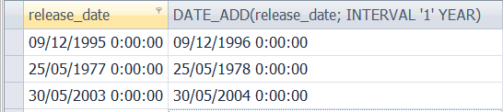
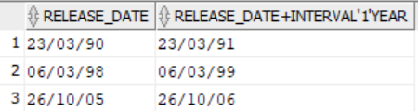
DATE OPERATIONS
Time Addition Functions Example
BBDD/User: moviebig
MySQL
SELECT release_date, DATE_ADD(release_date, INTERVAL '1' YEAR)
FROM moviebig;
Oracle
SELECT release_date,
release_date + INTERVAL '1' YEAR
FROM moviebig;

Slide 18
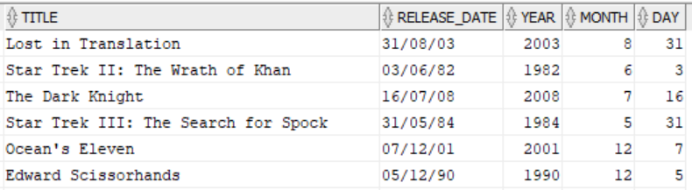
DATE OPERATIONS
Getting year, month and day from date
BBDD/User: moviebig
MySQL
Oracle
SELECT
title,
release_date,
YEAR(release_date) year,
MONTH(release_date) month,
DAY(release_date) day
FROM moviebig;
SELECT
title,
release_date,
EXTRACT(YEAR FROM release_date) year,
EXTRACT(MONTH FROM release_date) month,
EXTRACT(DAY FROM release_date) day
FROM moviebig;

Slide 19
SESSION 3
DATA IMPORTING
DML SELECT STATEMENT
DATE OPERATIONS
TEXT OPERATIONS
NUMBER OPERATIONS
DUMMY QUERIES

Slide 20
TEXT OPERATIONS
TEXT Concatenation Syntax
MySQL
CONCAT(Field1,Field2,...,FieldN)
Oracle
Field1 || Field2 || ... || FieldN

Slide 21
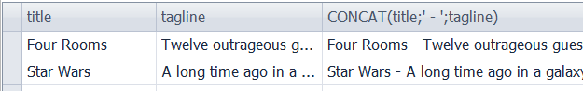
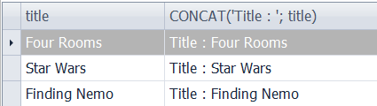
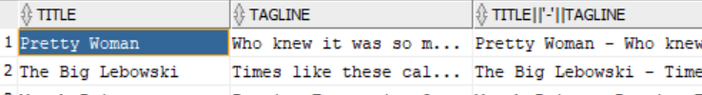
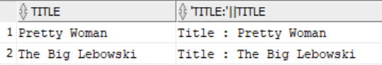
TEXT OPERATIONS
TEXT Concatenation Example
BBDD/User: moviebig
MySQL
SELECT title, tagline, CONCAT(title,' - ',tagline)
FROM moviebig;
SELECT title, CONCAT('Title : ', title)
FROM moviebig;
Oracle
SELECT title, tagline, title || ' - ' || tagline FROM moviebig;
SELECT title, 'Title : ' || title
FROM moviebig;

Slide 22
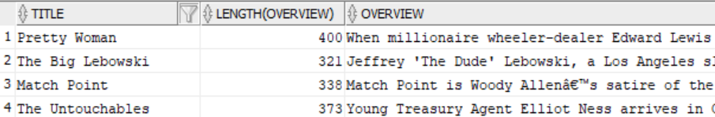
TEXT OPERATIONS
TEXT Length Syntax
MySQL/Oracle
LENGTH(TextField)
MySQL/Oracle
TEXT Length Example
BBDD/User: moviebig
SELECT title, LENGTH(overview), overview FROM moviebig;

Slide 23
TEXT OPERATIONS
LIKE Syntax
MySQL/Oracle
SELECT *
FROM table
WHERE Field1 LIKE '%Text%'
Note: By default, in MySQL LIKE is NOT CASE SENSITIVE. In Oracle is CASE SENSITIVE.

Slide 24
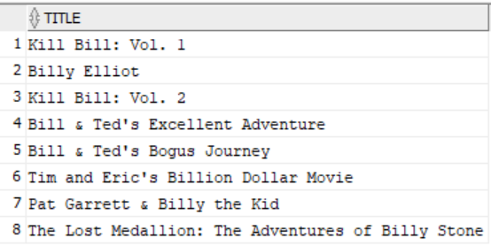
TEXT OPERATIONS
LIKE Example
BBDD/User: moviebig
MySQL/Oracle
SELECT title
FROM moviebig
WHERE title LIKE '%Bill%';

Slide 25
TEXT OPERATIONS
TEXT Conversion Syntax
MySQL
Oracle
DATE_FORMAT(DateValue, FormatDate)
TO_CHAR(DateValue, FormatDate)
UPPER and LOWER Case Syntax
MySQL/Oracle
LOWER(TextValue)
UPPER(TextValue)

Slide 26
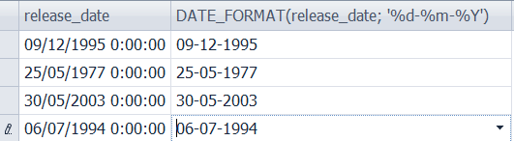
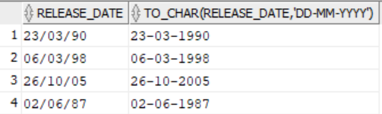
TEXT OPERATIONS
TEXT Conversion Example
BBDD/User: moviebig
MySQL
SELECT release_date, DATE_FORMAT(release_date, '%d-%m-%Y') FROM moviebig;
Oracle
SELECT release_date, TO_CHAR(release_date,'dd-mm-yyyy') FROM moviebig;

Slide 27
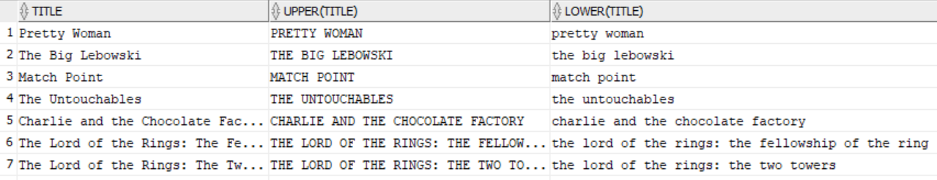
TEXT OPERATIONS
UPPER and LOWER Case Example
BBDD/User: moviebig
MySQL/Oracle
SELECT title , UPPER(title), LOWER(title)
FROM moviebig;

Slide 28
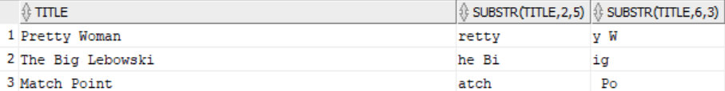
TEXT OPERATIONS
SUBSTRING Syntax
MySQL/Oracle
SUBSTR(TextValue, StartPosition , Length)
SUBSTRING Example
BBDD/User: moviebig
MySQL/Oracle
SELECT title, SUBSTR(title,2,5), SUBSTR(title,6,3) FROM moviebig;

Slide 29
TEXT OPERATIONS
Getting String Index Function Syntax
Oracle
INSTR(TextValue, StringToLookfor, PositionToStart)
MySQL
INSTR(TextValue, StringToLookfor)
LOCATE(StringToLookfor, TextValue, PositionToStart)
MySQL/Oracle
NOTE: If PositionToStart is not specified, by default it takes value : 1

Slide 30
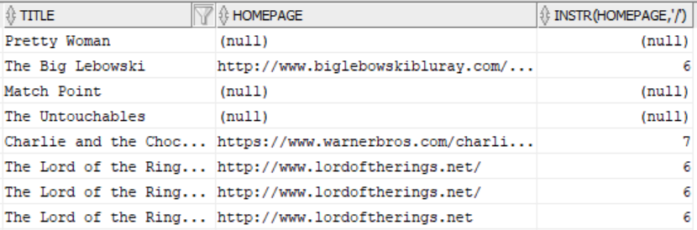
TEXT OPERATIONS
Getting String Index Function Example
BBDD/User: moviebig
MySQL/Oracle
SELECT title, homepage, INSTR(homepage,'/')
FROM moviebig;

Slide 31
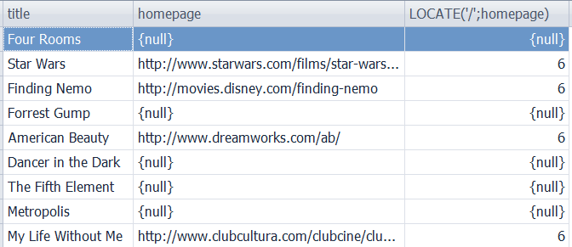
TEXT OPERATIONS
Getting String Index Function Example
BBDD/User: moviebig
MySQL
SELECT title, homepage, LOCATE('/',homepage)
FROM moviebig;

Slide 32
SESSION 3
DATA IMPORTING
DML SELECT STATEMENT
DATE OPERATIONS
TEXT OPERATIONS
NUMBER OPERATIONS
DUMMY QUERIES

Slide 33
NUMBER OPERATION
Arithmetic Functions Syntax
MySQL/Oracle
SELECT
CEIL(NumberField),
FLOOR(NumberField),
MOD(NumberField, ValueX),
ROUND(NumberField, DecimalNumbers),
TRUNC(NumberField, DecimalNumbers), /* ORACLE only */
POWER(NumberField, ValueX),
ABS(NumberField),
SQRT(NumberField)
FROM table;
NOTE: If DecimalNumbers is not specified, by default takes 0 as value.

Slide 34
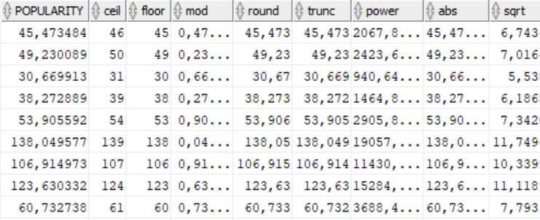
NUMBER OPERATION
Arithmetic Functions Syntax
BBDD/User: moviebig
MySQL/Oracle
SELECT popularity,
CEIL(popularity) "ceil",
FLOOR(popularity) "floor",
MOD(popularity,1) "mod",
ROUND(popularity,3) "round",
TRUNC(popularity,3) "trunc",
POWER(popularity,2) "power",
ABS(-popularity) "abs",
SQRT(popularity) "sqrt"
FROM moviebig;

Slide 35
SESSION 3
DATA IMPORTING
DML SELECT STATEMENT
DATE OPERATIONS
TEXT OPERATIONS
NUMBER OPERATIONS
DUMMY QUERIES

Slide 36




DUMMY QUERIES
BBDD/User: any
MySQL
Oracle
SELECT 50*32, 12*32;
SELECT SUBSTR('ABCDEFGHI',5,4);
SELECT SYSDATE();
SELECT "2021-01-30", DATE_ADD("2021-01-30" , INTERVAL '1' MONTH);
SELECT 50*32, 12*32 FROM DUAL;
SELECT SUBSTR('ABCDEFGHI',5,4) FROM DUAL;
SELECT SYSDATE FROM DUAL;
SELECT '30-01-2021', ADD_MONTHS('30-01-2021',1) FROM DUAL;

